Slide 1

Setup

Slide 2
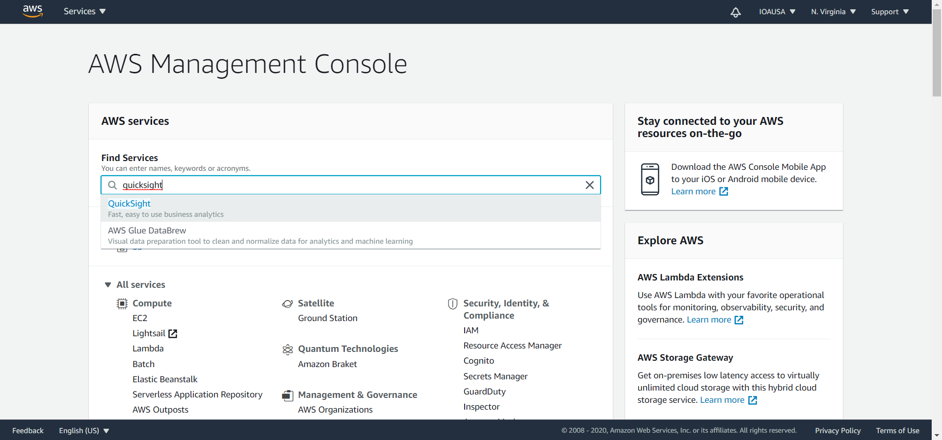
Search for ‘QuickSight’

Slide 3
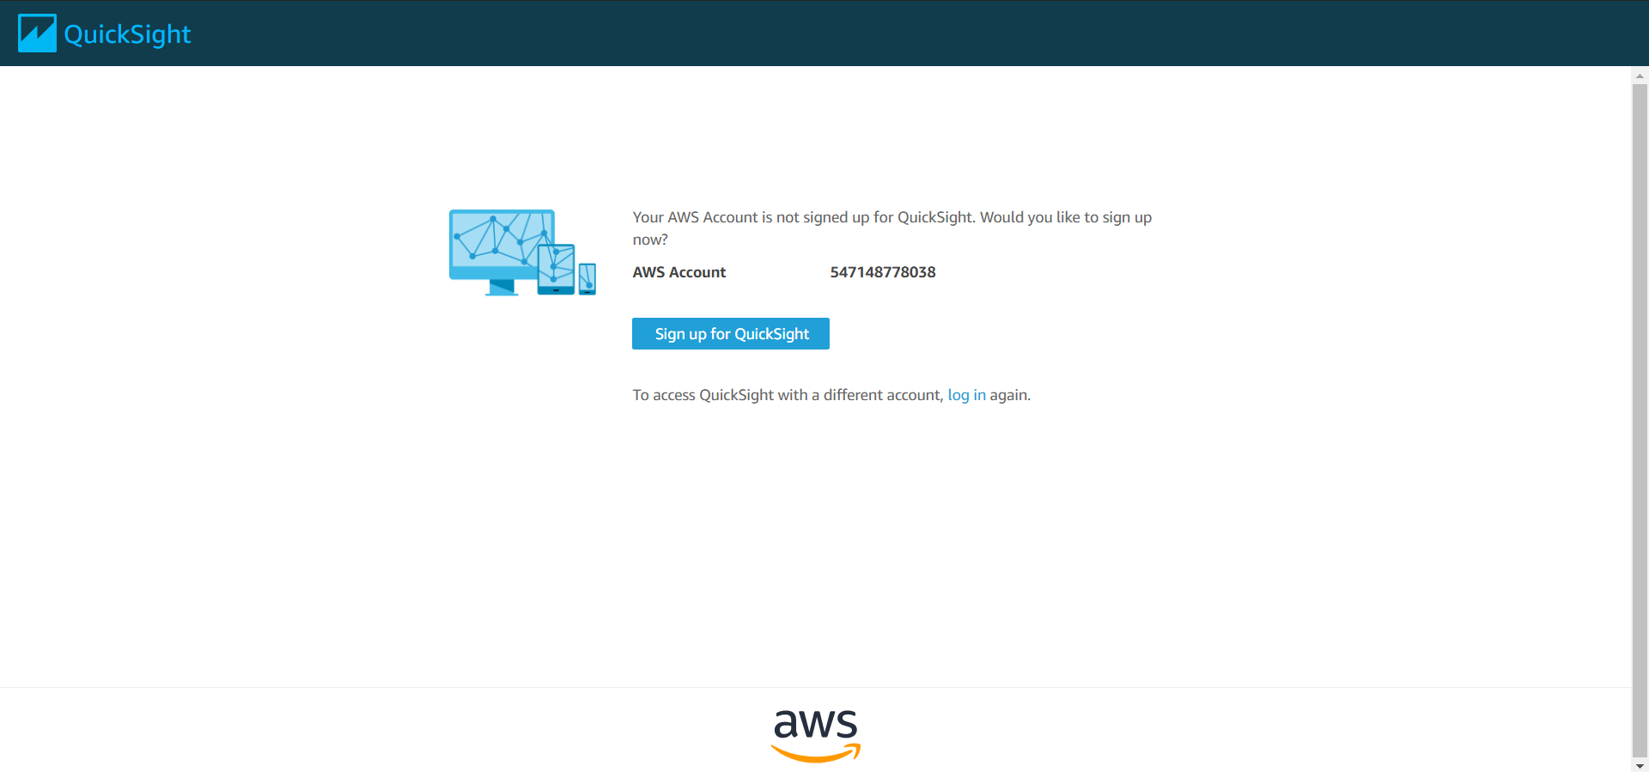

Slide 4
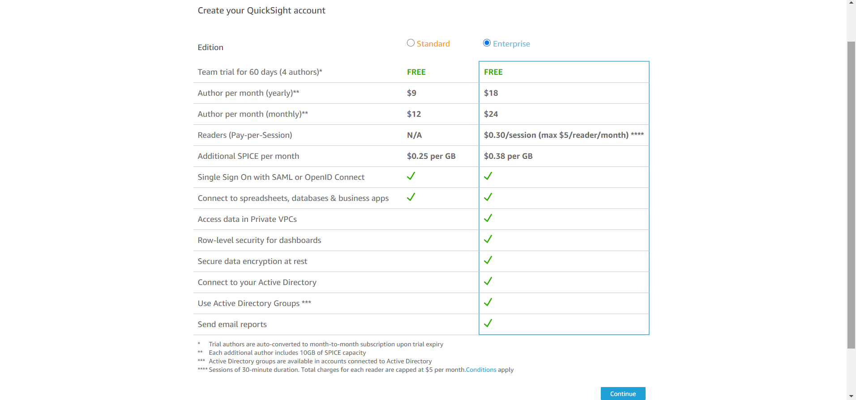
Compare and choose your Edition

Slide 5
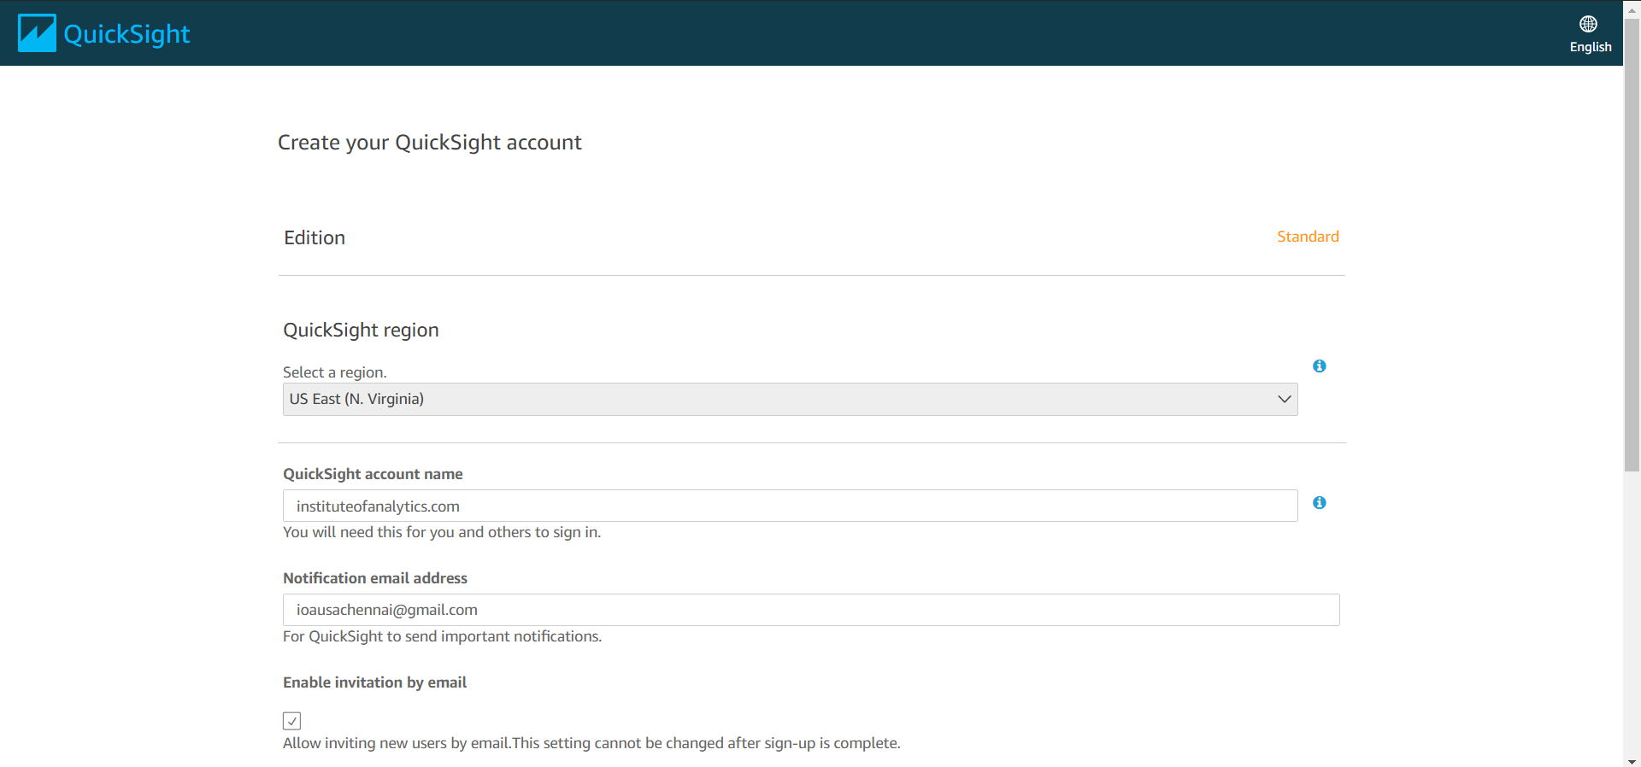
Create a account name

Slide 6
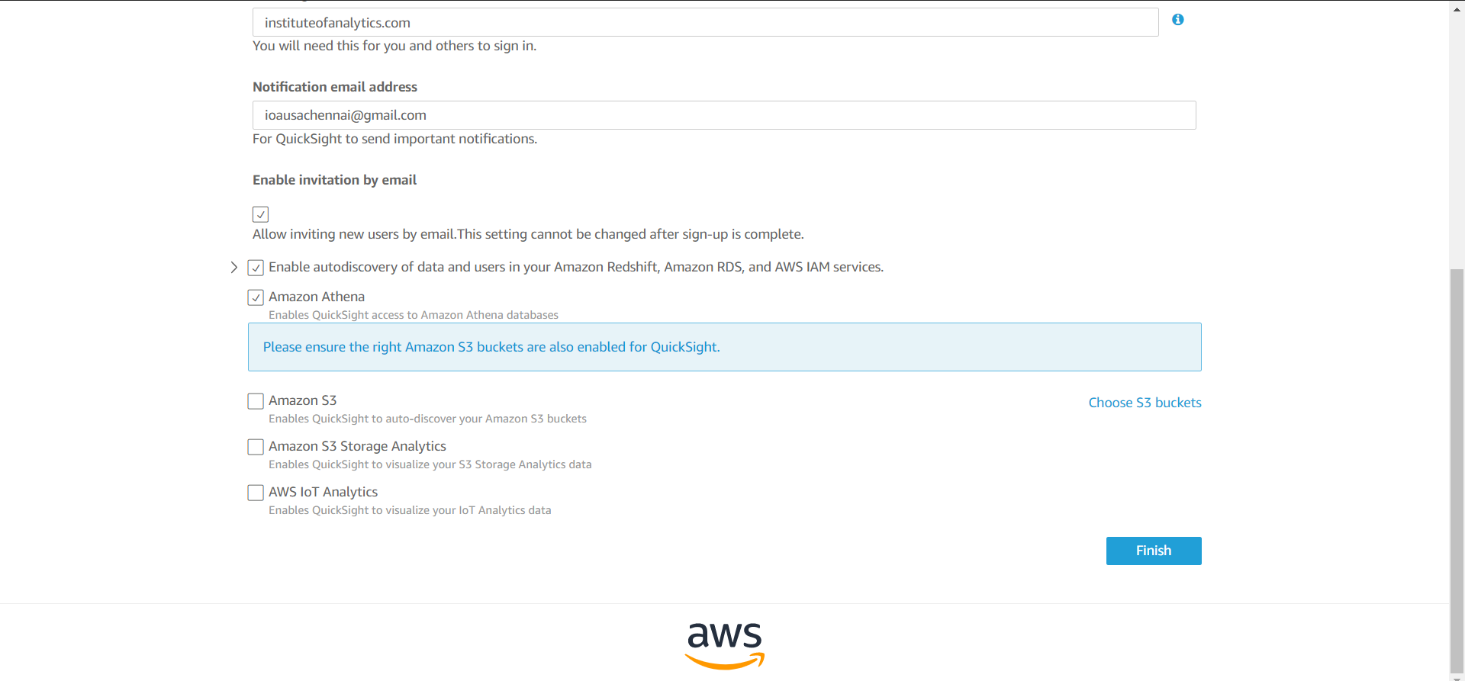
Enable S3 uploads

Slide 7
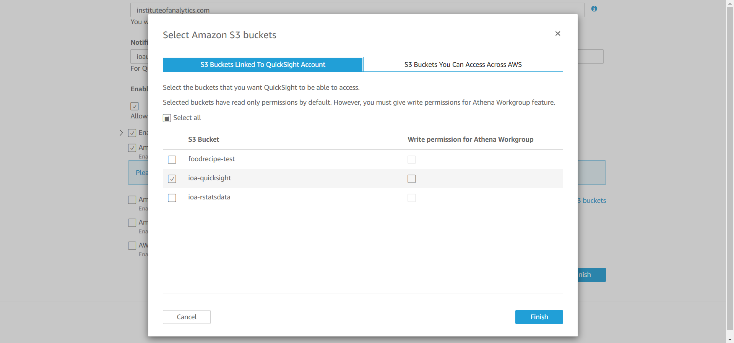
Give access to S3 Bucket(s)

Slide 8
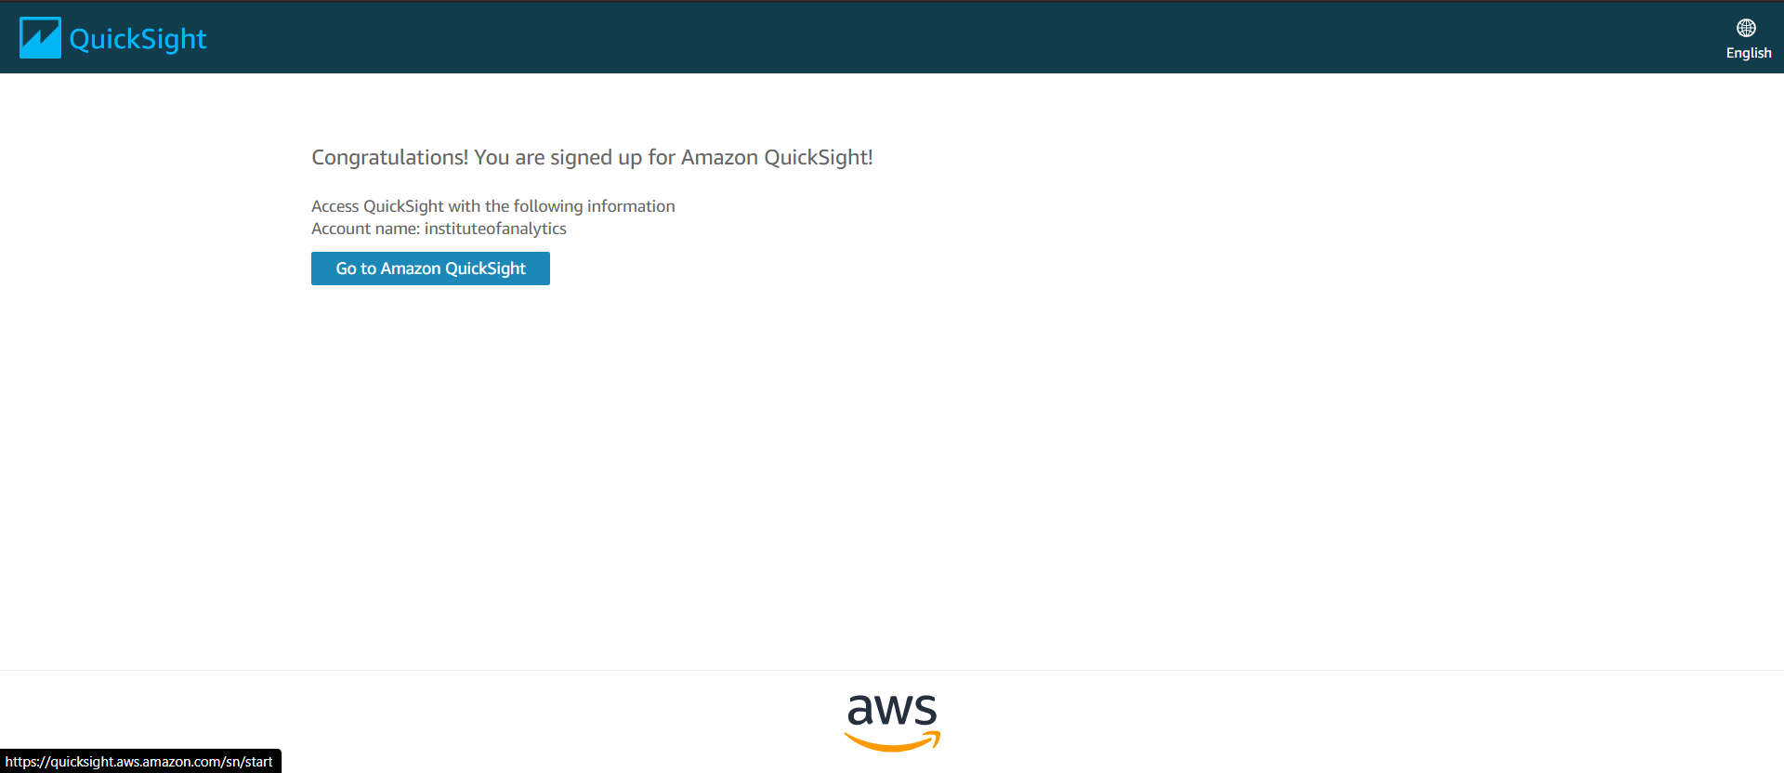

Slide 9
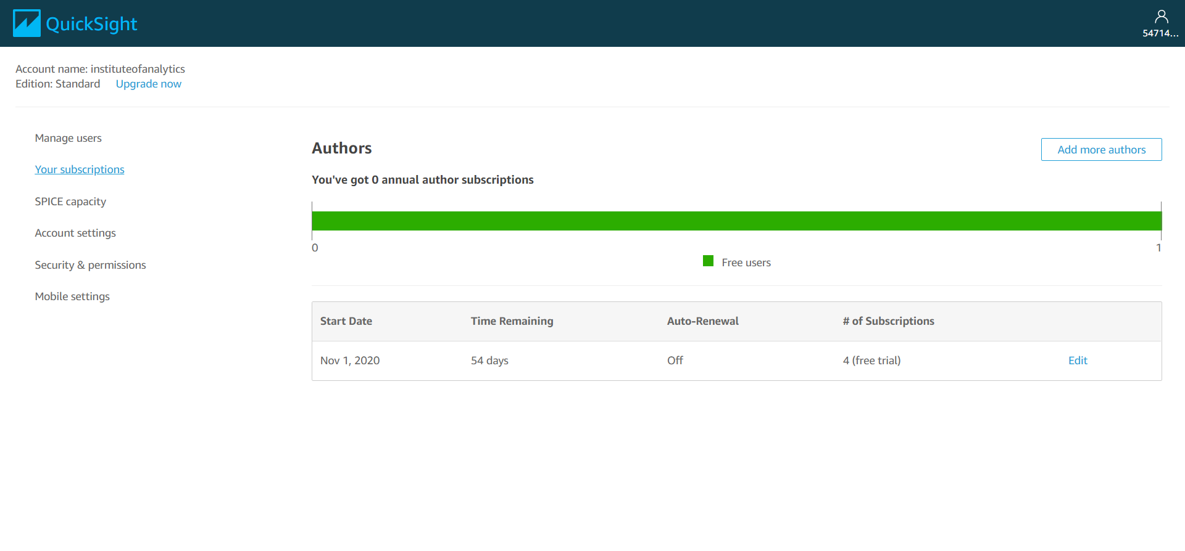
90 days free trial

Slide 10
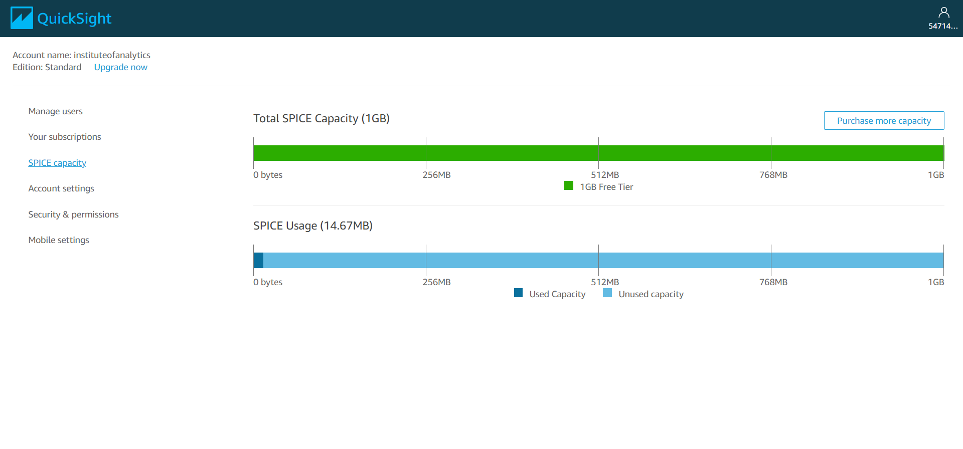
1GB of Storage for Free Tier

Slide 11
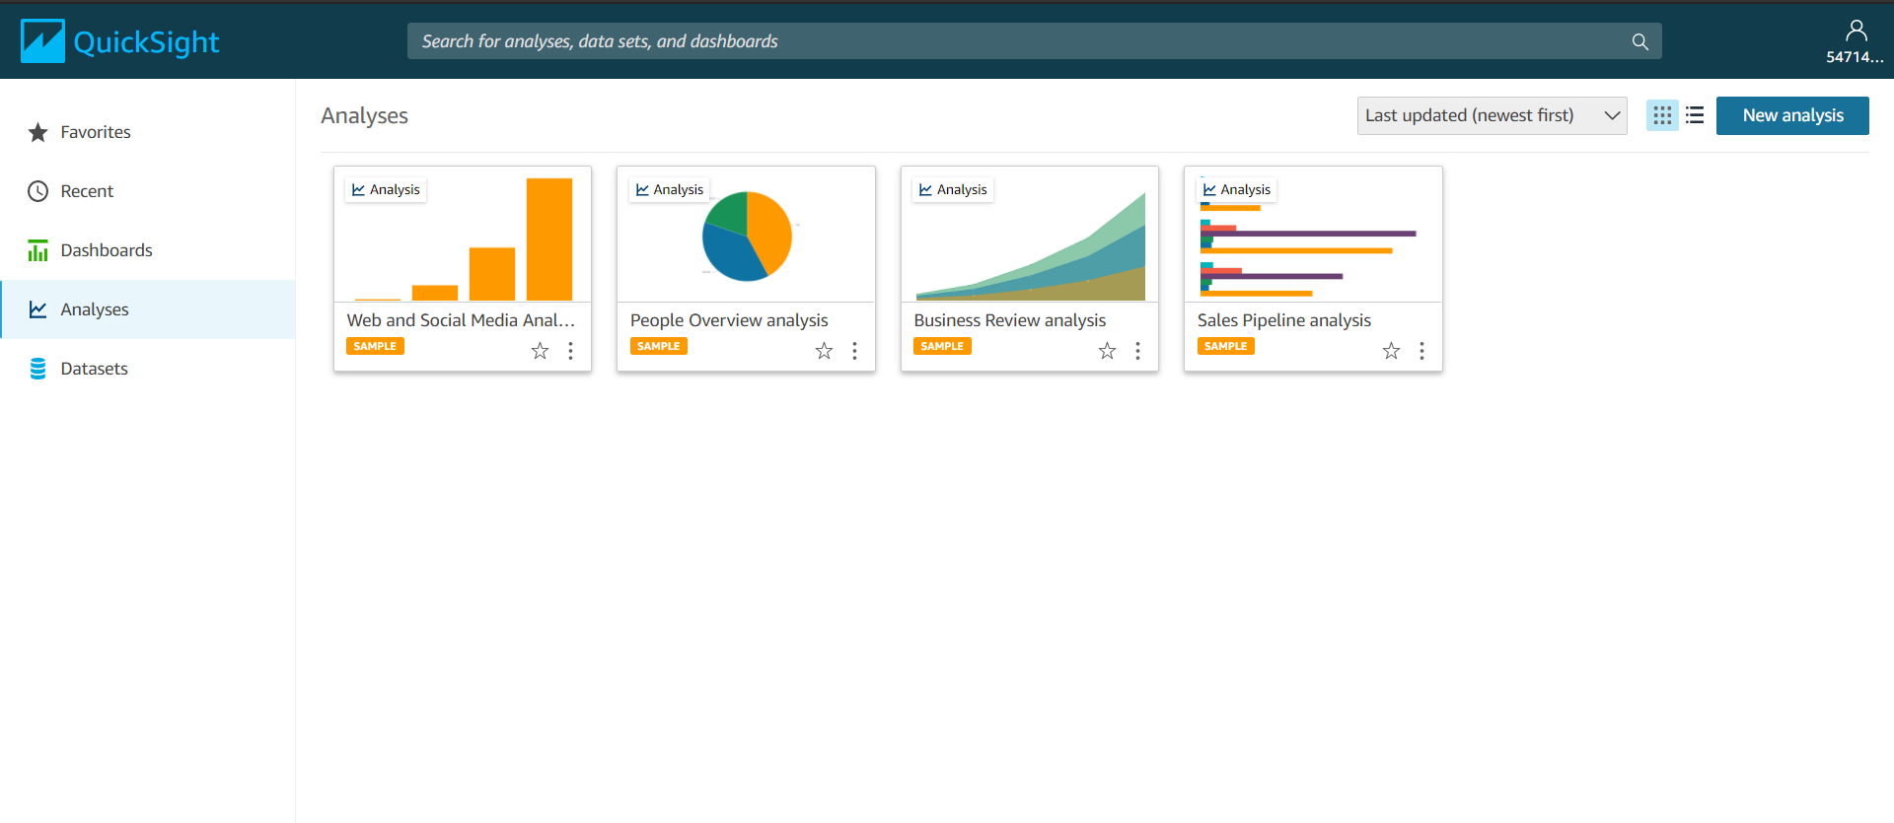
Sample Analyses available in AWS

Slide 12
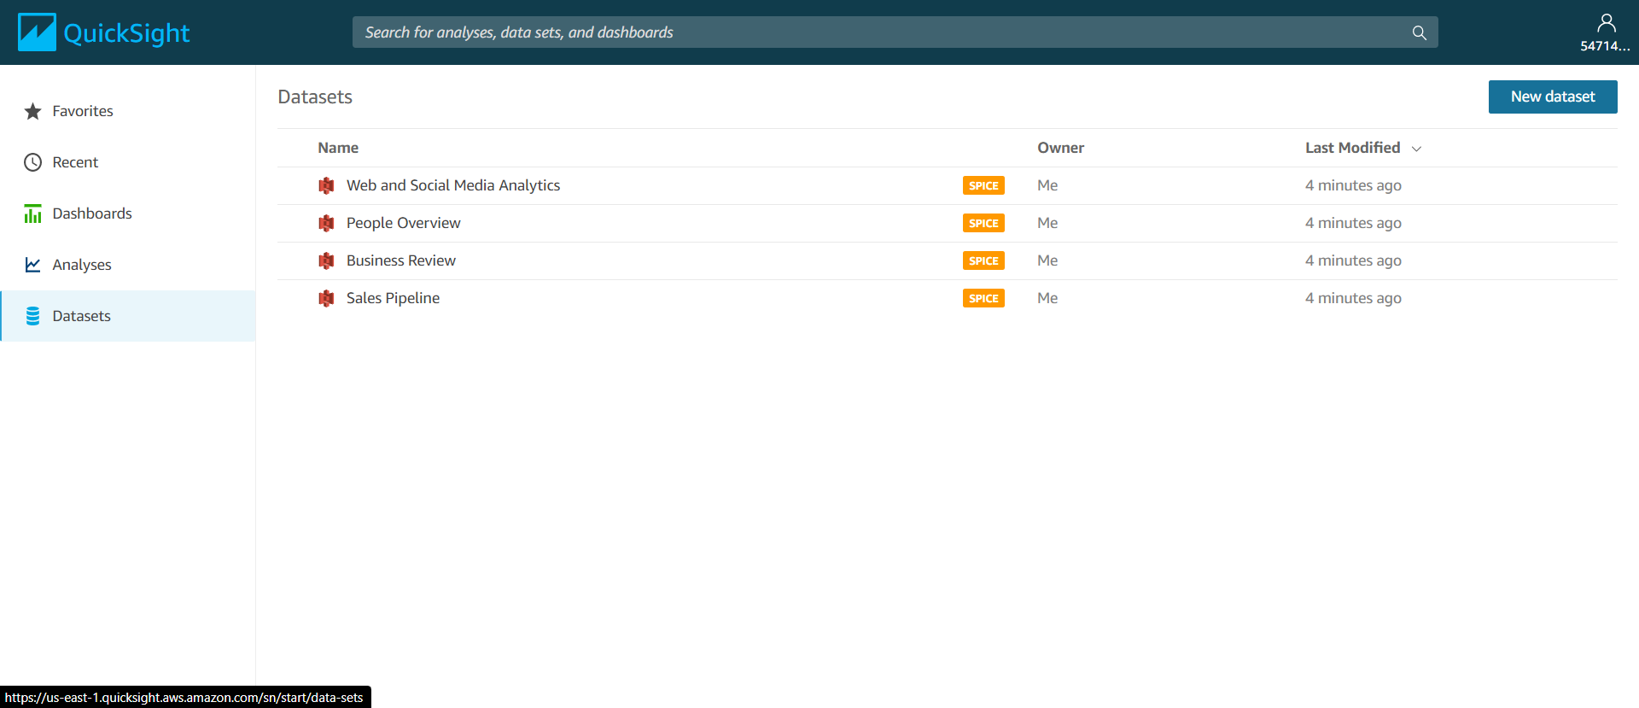
Upload Dataset
Sample Datasets available in AWS

Slide 13
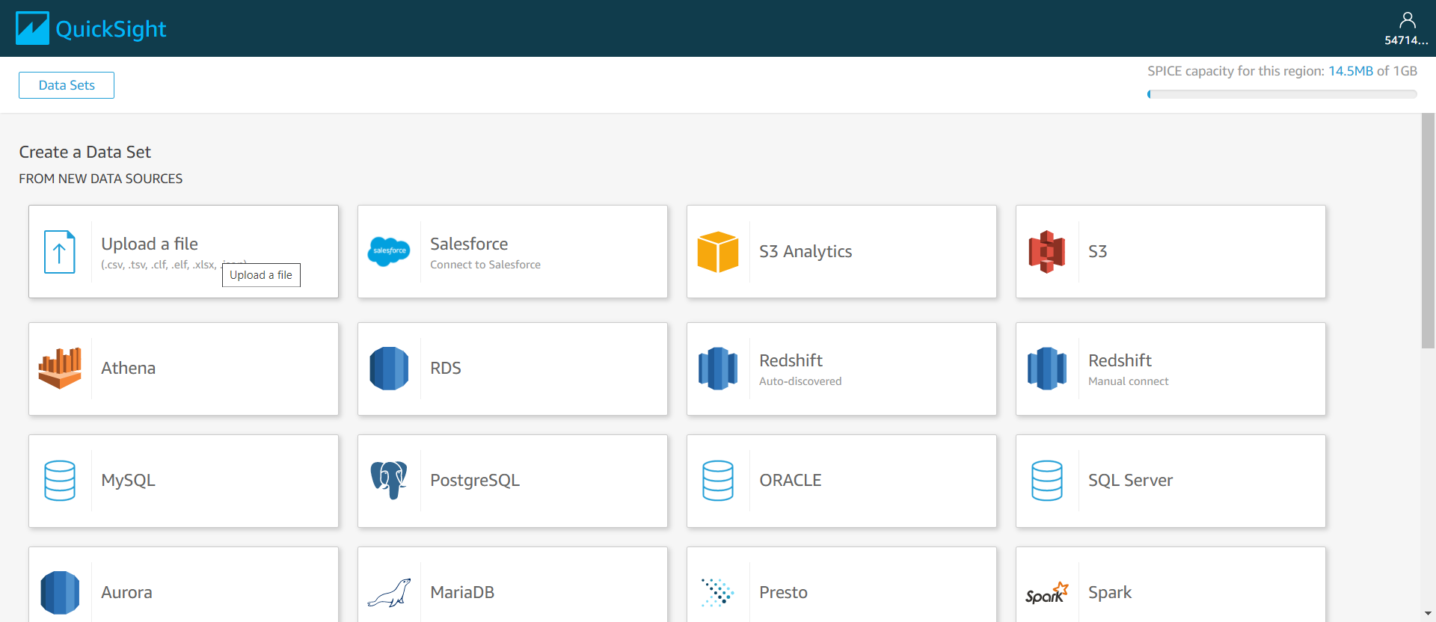
Upload CSV from local computer

Slide 14
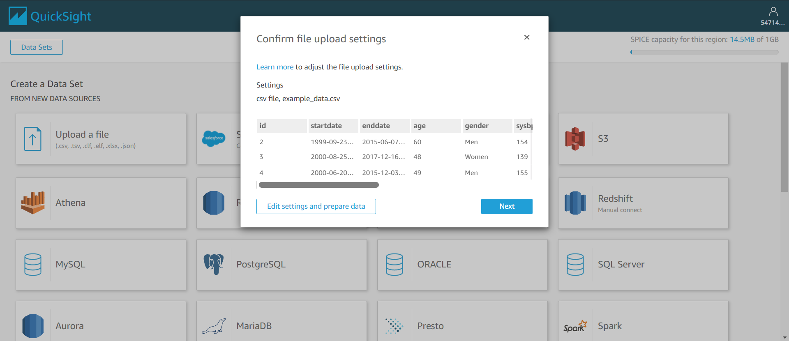
Dataset Preview

Slide 15
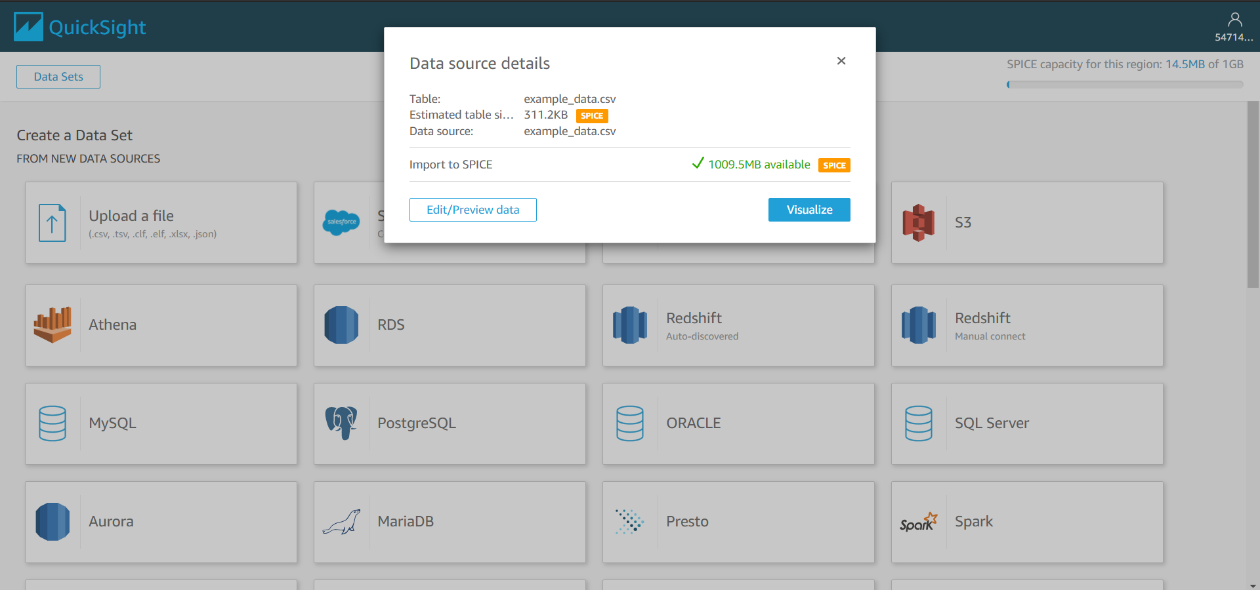
Edit Dataset or proceed to Visualize

Slide 16
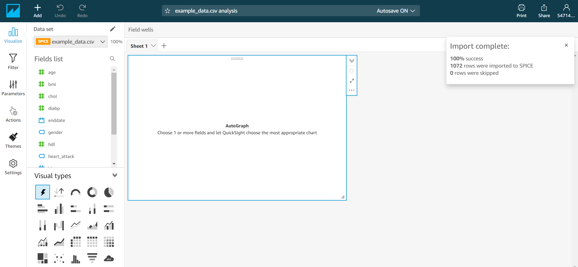
Data import confirmation
Dataset columns
Different types of charts

Slide 17
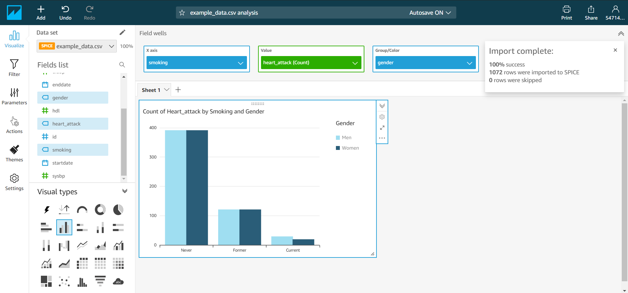
Vertical Bar Chart showing
“Count of Heart attack by Smoking and Gender”

Slide 18
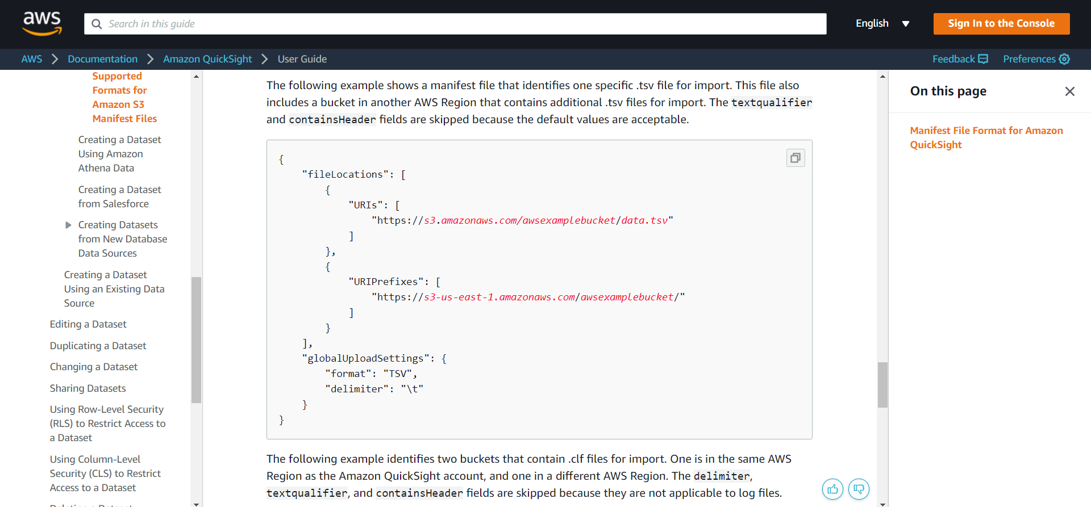
Supported Manifest File Format for S3 uploads

